Slide 1
Creating Effective Posters
Notes:
Look at this notes section for more context as you go through these slides on your own :)

Slide 2
In this workshop, we will. . .
1
Review the purpose of poster presentations
Identify qualities of effective posters
Discuss audience
Discuss the necessary written components
2
3
4

Slide 3
Why are posters important?
Posters are communication!
Notes:
Remember, posters help represent you and your research and/or institution, demonstrate your expertise, allow you to practice public speaking, share your ideas, and possibly create future collaborations

Slide 4
How do we use posters to communicate?
Disseminate knowledge/findings
Attract an audience of similar interest
Encourage interaction and discussion
Present or introduce dynamic visuals
Help build collegial relationships and collaborations

Slide 5



Effective posters are
Focused
on main ideas
Ordered with clear paths between sections
Graphic with ideas presented visually

Slide 6
Consider your audience
Engineering professionals in your field
Engineering professionals in related fields
Who are they?
Previously uninterested passersby
The judges!

Slide 7
Consider audience familiarity
Always aim to enhance viewer interpretation
What do they not know?
What information do they care about or want to know?
Notes:
Considering these questions can help make sure you are optimizing the content you are including on your poster and also help you out in your “sales pitch”!

Slide 8
Tips for preparing your poster
1
Define sections with expected information
Refer back to any competition/rubric rules
Write simple and concise text
Ensure poster can stand alone
2
3
4

Slide 9
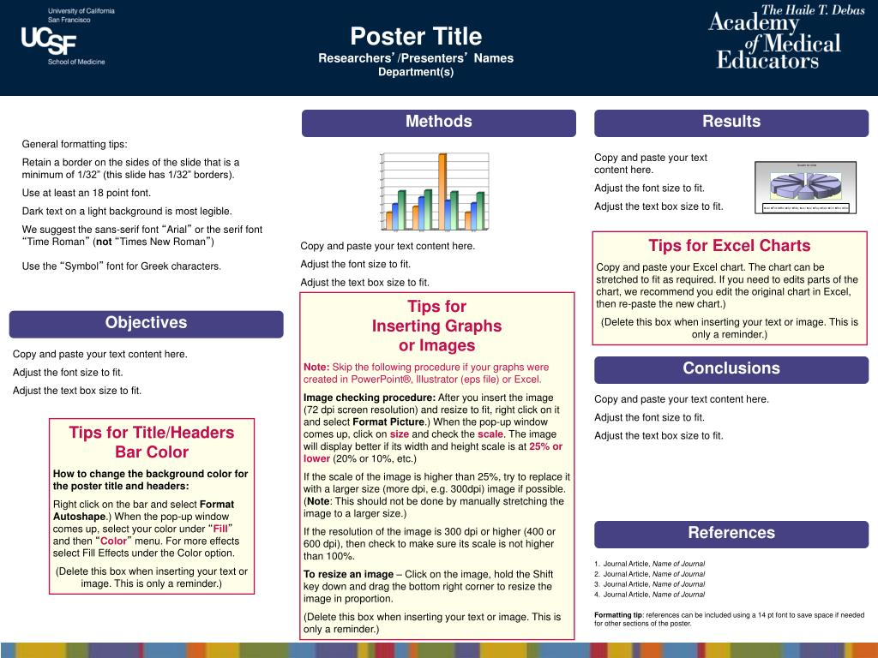
What information goes on a poster?
Introduction
1. Title
2. Name and Institution
Notes:
Title and name of institution printed nice and clear at the top in bigger font

Slide 10
What information goes on a poster?
3. Core content
Introduction
Intro or background/client need and design objective
Methods/steps taken to address problem (e.g computer-aided design, calculations, prototyping)
Final design solution features
Recommendations/next steps
Notes:
Will go over these in more detail in next slide

Slide 11
Introduction to the Problem
Background/client need, design objectives
Plan around 2-3 key points
Use design objectives to organize
Can use graphics to emphasize
Gets viewers interested
Notes:
This might look like a background paragraph or a problem statement but introduction section works to introduce the problem your design solves
This involves talking about the background context/client need and any relevant design objectives: What real world issue were you inspired to solve through your design/what it is solving? What were the needs of your audience or client? Essentially, WHAT IS THE PROBLEM?
Plan around 2-3 key points, Use your design objectives to organize
Include a hook or appeal to get viewers interested. Why should people care about the reason for your design?

Slide 12
What information goes on a poster?
3. Core content
Introduction
Intro or background/client need and design objective
Methods/steps taken to address problem (e.g computer-aided design, calculations, prototyping)
Final design solution features
Recommendations/next steps
Notes:
Will go over these in more detail in next slides

Slide 13
Methods and Materials
Describes procedure and methods to solve problem
Prior market approaches
Software, prototyping methods, materials used
Experimental measurements (if conducted)
Why you chose the approach
Challenges
TIPS
Use brief descriptions
Keep it simple: No clutter, jargon or extra technical detail
Notes:
Through your design you should also include a section that defines the methods to your solution: This might look like a methods/materials section or a section that speaks to design constraints. Ultimately, you want to still speak to how are you solving the problem with your design and what methods did you use to do so. With this you might consider prior market approaches. What has already been done?
You might include the software and prototyping methods as well as any materials that you used that were relevant in building your design
You can also mention why you chose that approach which will give you more credibility as the person presenting the design
You can also include any challenges you may have faced which also helps demonstrate the problem solving aspect of you project/and where there is potential room for improvement

Slide 14
What information goes on a poster?
3. Core content
Introduction
Intro or background/client need and design objective
Methods/steps taken to address problem (e.g computer-aided design, calculations, prototyping)
Final design solution features
Recommendations/next steps
Notes:
Will go over these in more detail in next slides

Slide 15

Design solution
Largest section
Summarize design features and results of testing or modeling
Make image-based, few words
Maximize use of figures
Minimize use of tables
Use legends/captions as text
Notes:
Remember, this is what draws attention to your poster!
Use legends and captions. People need to know what they're looking at. Have you ever looked at a graph and not known what you were looking at? Try not to be that kind of presenter.

Slide 16
What information goes on a poster?
3. Core content
Introduction
Intro or background/client need and design objective
Methods/steps taken to address problem (e.g computer-aided design, calculations, prototyping)
Final design solution features
Recommendations/next steps
Notes:
Will go over these in more detail in next slides

Slide 17
Conclusions and Next Steps
Interpret the meaning or implication of results
Recommend follow up steps (e.g. manufacturability or constructability of solution; additional testing)
Don’t insist readers translate findings themselves (because many won’t)
Tie back to real world issues
Familiarize yourself with possible applications of your project
Connect results to audience
Why is it important? Why should we care?
Notes:
Ideally, someone could take this and help it come to fruition so it’s helpful you give those recommendations and next steps.
You might also consider these questions: how is your design potentially better or more effective to what exists now?

Slide 18
What information goes on a poster?
Introduction
4. Citations and Acknowledgements

Slide 19

References
Usually short
Reference sources utilized on the poster
If it’s cited, it needs a reference

Slide 20
Acknowledgments
Thank faculty, staff, and advisors who supported you
Identify funding sources if any

Slide 21
What information goes on a poster?
Introduction
5. Visuals
Notes:
Visuals have the most impact and they’re the first thing our eyes jump to. Make sure your visuals have significance and prioritize presenting them in a logical, meaningful way.

Slide 22
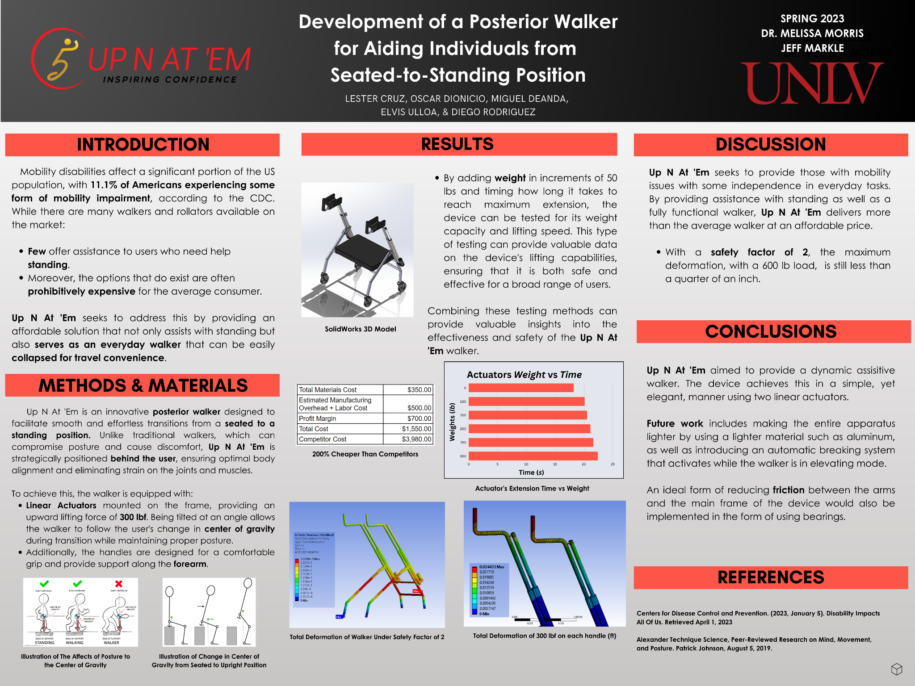
Notes:
Example from a former peer. Remember, there is no such thing as a perfect poster, but we can aim for clearer, effective presentation. This is an example of something to aim for.

Slide 23
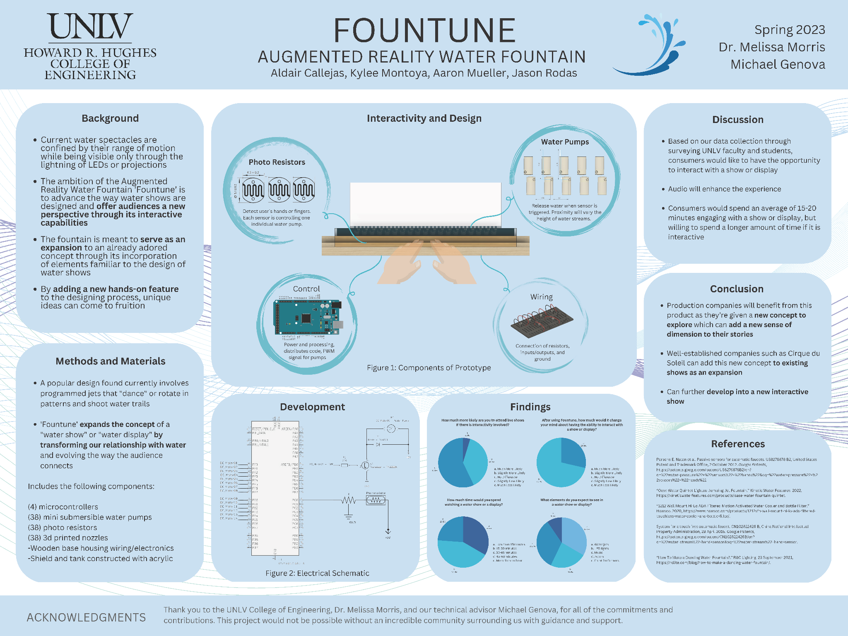
Notes:
Example from a former peer. Remember, there is no such thing as a perfect poster, but we can aim for clearer, effective presentation. This is an example of something to aim for.

Slide 24
Review: Successful Communication
All required components are present, clearly laid out, and easy to follow
Information is focused, ordered, and graphic
Text is concise, uses simple language, and prioritizes the most important points
Visuals are attractive, enhance understanding, are easy to read, and are properly labeled
Elevator speech is prepared to engage your audience

Slide 25

The Writing Center
Location
Campus Resource Center
Room 216 (2nd Floor)
Contact
(702) 895-3908 writingcenter@unlv.edu
For hours, handouts, and resources, see our website:
unlv.edu/writing-center
Notes:
The Writing Center can help you make your written content more concise and easier to read so you can paste it on your poster in an organized fashion. We can help you with research papers and statements of purpose if you’re applying for grad school too!

Slide 26
Works Cited
“How to Create a Research Poster: Poster Basics.” NYU Libraries, 20 April 2017, guides.nyu.edu/posters
Miller, Jane. “Preparing and Presenting Effective Research Posters.” Health Services Research, vol. 42, no. 1, Feb. 2007, pp. 311-328. PMI, doi:10.1111/j.1475-6773.2006.00588.x
Price, Michael. “The perfect poster.” American Psychological Association, Jan. 2011, www.apa.org/gradpsych/2011/01/poster.aspx
Stuckey, Matthew. “How to Make an Effective Poster.” UC Davis, n.d. urc.ucdavis.edu/sites/g/files/dgvnsk3561/files/local_resources/documents/pdf_documents/How_To_Make_an_Effective_Poster2.pdf

Slide 27



Research
Poster Design
Notes:
We are now going to transition into the design portion of this workshop.
-You do not need to be an artist to create a visually appealing poster
-Hopefully through sharing these tips you’re able to go into this design process more confidently

Slide 28




Agenda
Elements of a poster
Examples
Resources
Notes:
Mention Agenda

Slide 29
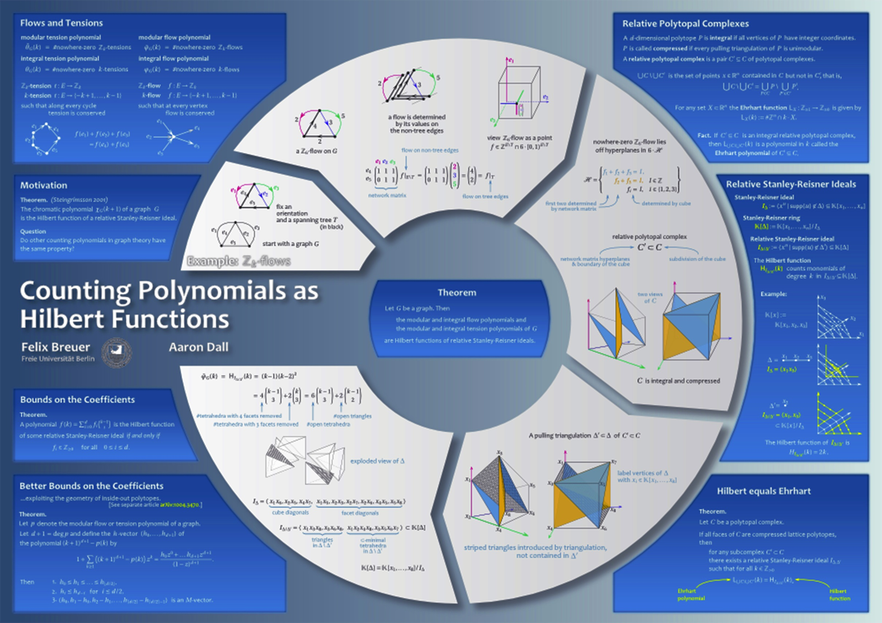
Notes:
Before we dive into any of our design tips and best practices, what do you think of this poster?
What do you like or dislike about it?

Slide 30

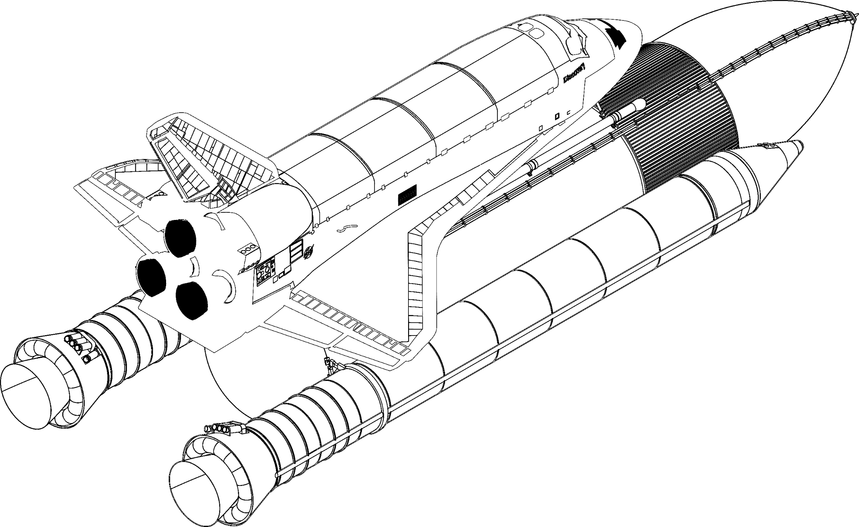
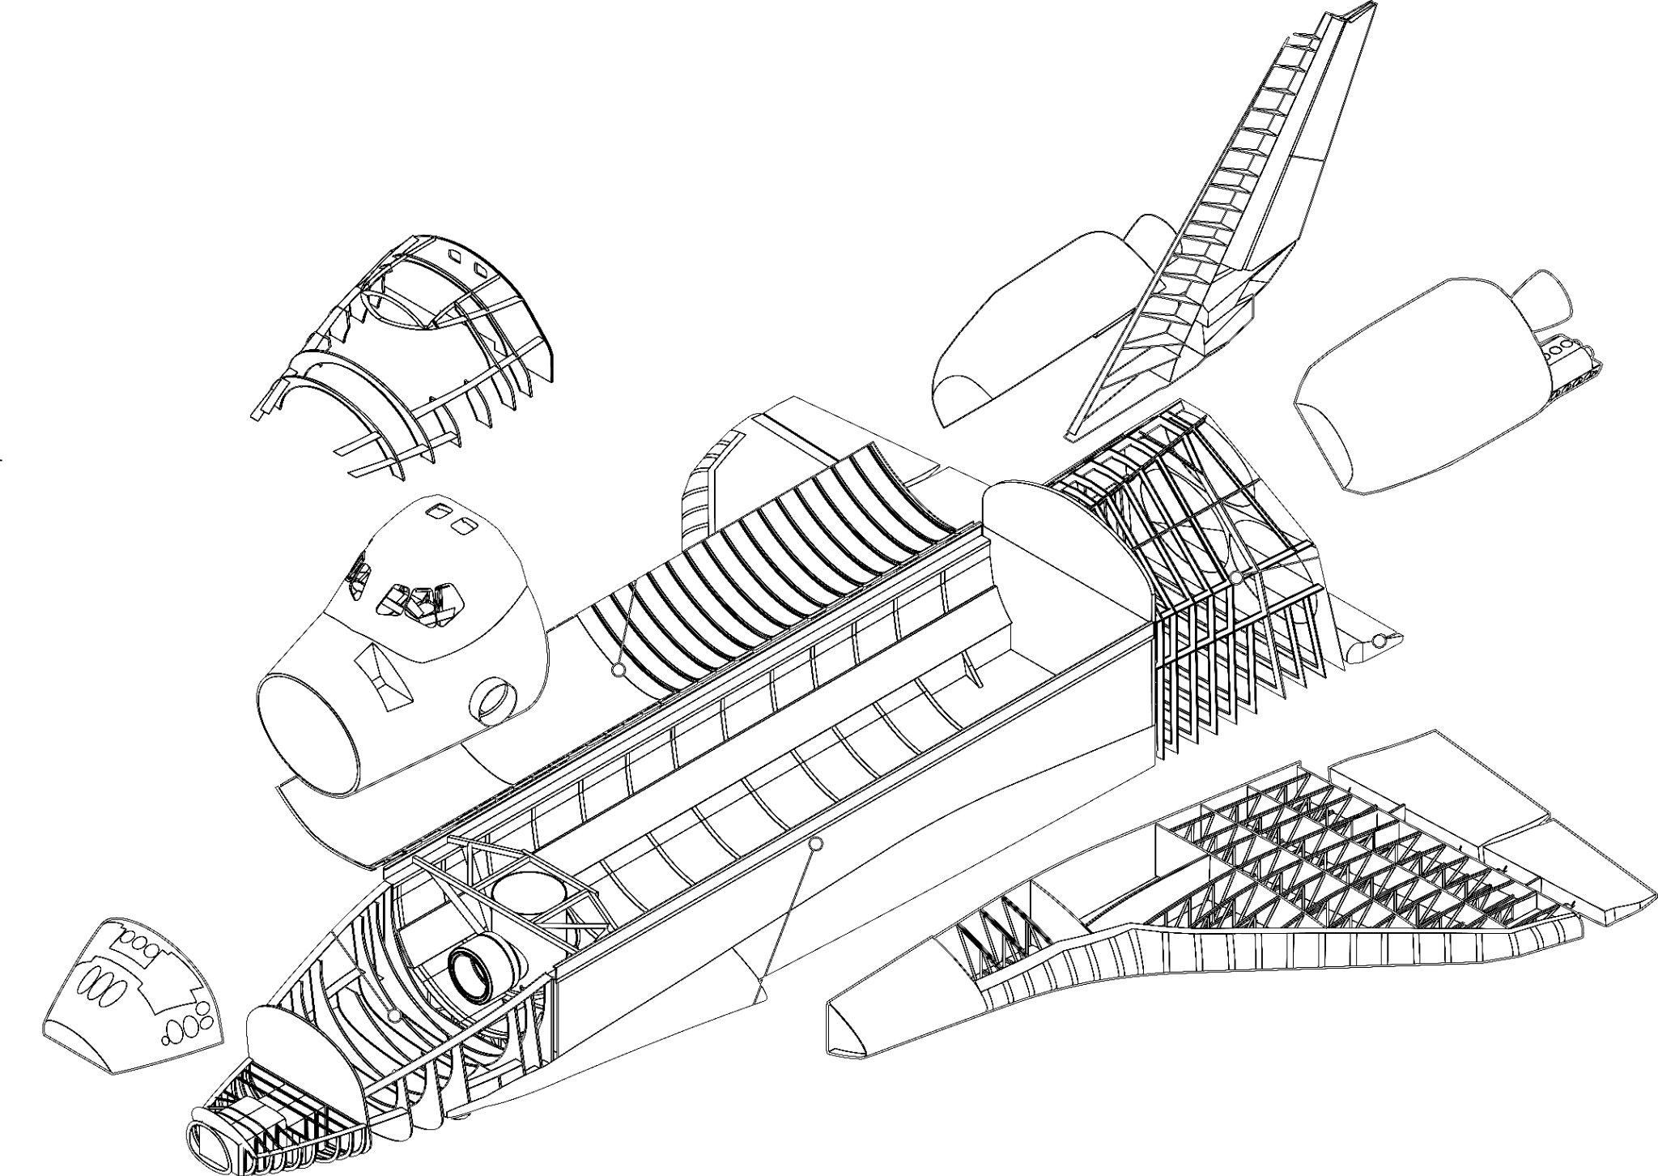
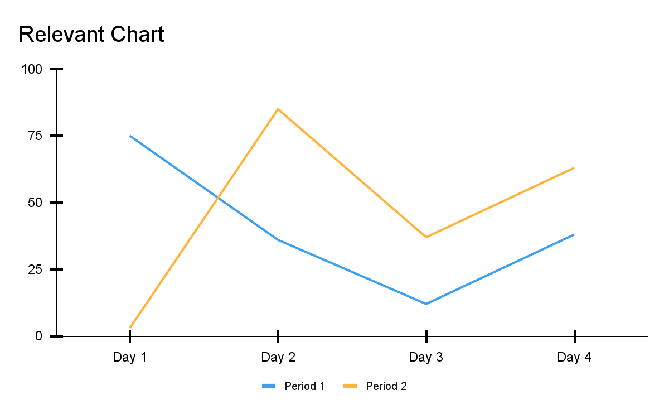

Poster Layout
Background
Next Steps
Final Design
Methods/Prototypes
Figure 2: Final design
References
Figure 3: Chart
Figure 1: Prototype 1
Notes:
All that being said, one of the first design elements I want to touch on is Poster Layout.
This will affect a lot of the checkboxes we saw on the previous slide: legibility, approachability, etc.
What you are looking at is a copy of the traditional poster layout that has been used over the last couple decades.
Break down layout, Pros v Cons, slight differences depending on area of study.

Slide 31
Background
Discussion
Insert main finding.
Prototypes
Next Steps
Results
References
Credit: Mike Morrison
Notes:
Why a poster?
Explain where posters have been historically used
Allows you to network with people in your field
A way to advertise your work and talk to ppl
It’s required

Slide 32
Background
Discussion
Insert main finding.
Prototypes
Next Steps
Results
References
Credit: Mike Morrison
Notes:
Why a poster?
Explain where posters have been historically used
Allows you to network with people in your field
A way to advertise your work and talk to ppl
It’s required

Slide 33


Slide 34
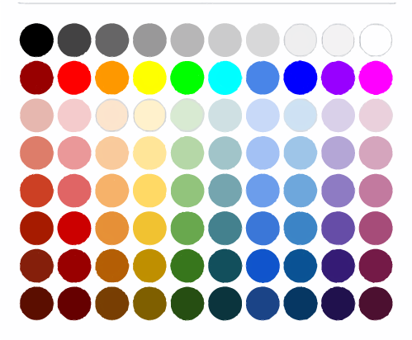

Choosing Your Colors
Be wary of saturated colors
Stick to 3-5 colors max
Dominant
Supporting
Accent
Adobe
Color wheel
Notes:
When it comes to colors, keep it simple! It’s easy to overthink what colors to use and how many of them.
I recommend playing it safe and sticking to 3-5 colors max. I always like to start with a color that sets the tone or kind of matches the theme of my project. I will then find two other colors that will work well with it.
The most prominent “color” on your poster will typically be your background color. Try to pick something that is easy to create contrast with, lighter shades work great here OR you keep it simple with a white background, OR a dark colored background, just be sure to use light colored fonts to create enough contrast.
Stay away from saturated colors for your background!!! These will significantly decrease the legibility of your text and can make it difficult to add elements like images, icons, logos, etc.

Slide 36
F
ont
Style
Font Style | Examples | Uses
Sans Serif | Arial Calibri Century Gothic | Recommended for your research poster, slide deck, infographic, etc.
Serif | Times New Roman Georgia Lora | Typically used for long bodies of text: books, pamphlets, essays.
Decorative | Caveat Pacifico | Not recommended for academic posters.
2 styles max!

Slide 37
F
ont
Size
Color
24 pt. font
30 pt. font
36 pt. font

Slide 38

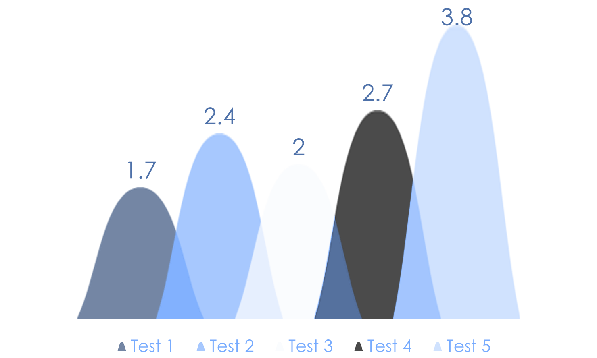

Images
Charts
Notes:
-What purpose does the image serve?
-Don’t add images or charts that people will ignore
-Does it help you convey your message?
-Resolution for both charts and images

Slide 39
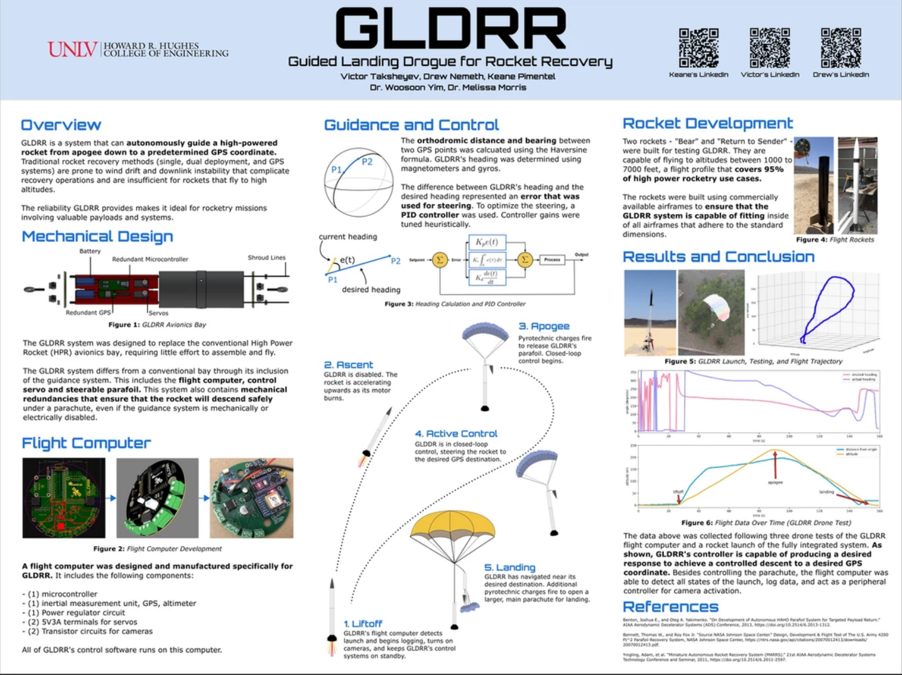
Notes:
This poster incorporates all of the tips that i’ve shared with you today.
-Layout is easy to follow
-Great use of visual aids which help communicate the information
-all pictures and charts are labeled
-colors theme is simple and is easy to read, same with fonts

Slide 40
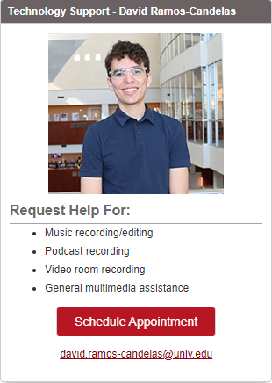

Need additional help?
Consultations are available!
david.ramos-candelas @unlv.edu
Notes:
Feedback

Slide 41
Please visit link before for tips on creating an inviting presentation poster!
https://www.youtube.com/watch?v=SYk29tnxASs&t=833s

